Slide 1
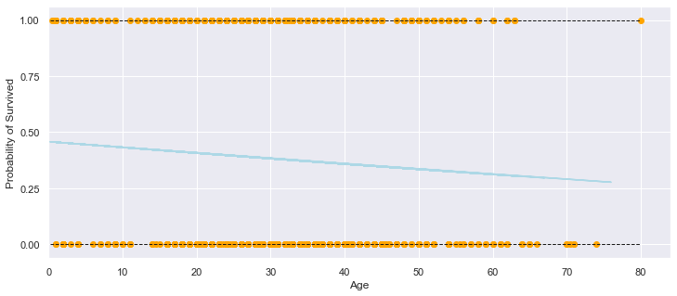
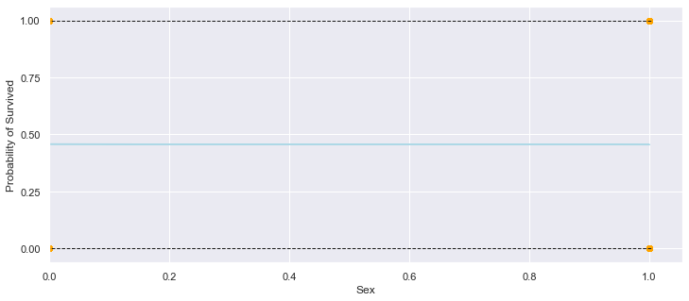
MATH 4995 Mini-Project 1: Predict survival on the Titanic
Ching Kwok Yan kychingaa@connect.ust.hk
1. Introduction
4. Methodology
5. Prediction and Analysis
The goal of this project is to predict survival on the titanic with machine learning method and the data provided in Kaggle.
0.7655 score is given on Kaggle for the logistic regression with only the feature ‘Sex’ is given and more women survived on the Titanic.
0.62200 score is given on Kaggle for the the logistic regression with only the feature ‘Age’ is given and more women survived on the Titanic.
0.75598 score is given on Kaggle for the the logistic regression with only the feature ‘Age’, ‘Pclass’ and ‘Sex' is given and more women survived on the Titanic
Methodology
I only used Logistic regression as I faced technical issues when using other methodology such as the error of the types is not compatible .
First I use logistic regression with all the features provided. However, the regression does not converge and needed to be stopped with maximum iteration. So logistic regression using only the feature ‘sex’, ‘age’ and ‘Pclass’.
2. The Dataset
This dataset contains 1 output(survived or not) with 12 features including‘Survived','Pclass','Sex','Age','SibSp','Parch','Fare','Cabin','Embarked','Ticket’,’Name’,’PassengerId’.
3. Data Preprocessing
The dataset is preprocessed. ‘Sex’ , ‘Embarked’ is encoded into number. The missing information for ‘Age’ and ‘Pclass’ is encoded with the median of the ‘Age’ and ‘Pclass’ of the training data set. Some Features such as ‘Name’ is dropped as it contains too many unique values and is hard to process. Also, ‘Cabin’ is dropped as many of the values in cabin is missing. I also dropped ‘Ticket’ and ‘PassengerId’.
6. Conclusion
Women and children were more likely to survive on Titanic
7. References
https://www.kaggle.com/c/titanic/overview
Mean Square Error vs. alpha

